Slide 1

Containerization for R&D Applications (Part 2): Singularity
Andrew Monaghan
Andrew.Monaghan@colorado.edu
Slides and exercises available for download at:
https://github.com/ResearchComputing/Containers_Fall_2021
Please fill out the course evaluation survey:
http://tinyurl.com/curc-survey18

Slide 2
Outline
Part 1: Container fundamentals and Docker (this past Tue)
Introduction to containers
Docker commands and options
Hands-on: Running Docker containers on your personal Machine
Hands-on: Building Docker images
Hands-on: Practical Application
Part 2: Containers for HPC with Singularity (12/2/21) – Today!
Singularity commands and options
Hands-on: Running containers
Building containers
Special cases: Running containers for MPI and GPU jobs

Slide 3
What is a container?
A container is a portable environment that packages some or all the following: an operating system, software, libraries, compilers, data and workflows. Containers enable:
Mobility of Compute
Reproducibility (software and data)
User Freedom

Slide 4


Containerization software
Docker
Part 1 - focus of tutorial given previously
Well established – largest user base
Has Docker Hub for container sharing
Problematic with HPC
Singularity/Apptainer*
Part 2 - focus of this tutorial
Designed for HPC
**Note: Sylabs spun off the open-source version of Singularity to the Linux Foundation in November 2021. This open-source version has been renamed “Apptainer” to distinguish it from the commercial product, “Singularity” that will still be marketed by Sylabs.

Slide 5
Why Singularity?
Singularity is a comparably safe container solution for HPC
User is same inside/outside container
User cannot escalate permissions without administrative privilege
Can support MPI and GPU resources on HPC (scaling)
Can use HPC filesystems
Supports the use of Docker containers
Container is seen as a file, and can be operated on as a file

Slide 6
Singularity Overview
Singularity Workflow
Key Commands
Running Containers
Seacontainersales.com

Slide 7
The Singularity Workflow
Need Container?
no
Build software in situ on host system
yes
Does Container Exist?
yes
Run container
no
Build Container
We’ll cover this last
We’ll cover this first

Slide 8
Where do I find existing containers?
Docker Hub: https://hub.docker.com
Sylabs Library: https://cloud.sylabs.io/library
Tutorial on finding a running an existing Docker container: https://www.chpc.utah.edu/documentation/software/singularity.php#exd

Slide 9
Key Singularity Commands
build: Build a container on your user endpoint or build environment
exec: Execute a command to your container
inspect: See labels, run and test scripts, and environment variables
pull: pull an image from Docker or Singularity Hub
run: Run your image as an executable
shell: Shell into your image
More: https://www.sylabs.io/guides/3.2/user-guide/cli.html

Slide 10
Running containers
Now, on any system with Singularity, even without administrative privilege, you can retrieve and use containers:
Download a container from Singularity Hub or Docker Hub
singularity pull shub://some_repo/some_image
singularity pull library://some_repo/some_image
singularity pull docker://some_repo/some_image
Run a container
singularity run mycont.sif
Execute a specific program within a container
singularity exec mycont.sif python myscript.py
“Shell” into a container to use or look around
singularity shell mycont.sif
Inspect an image
singularity inspect --runscript mycont.sif

Slide 11
Running Containers
Navigate to the tutorial:
https://bit.ly/3lvwO4p
Seacontainersales.com
The tutorial can also be found here:
https://github.com/ResearchComputing/Containers_Fall_2021

Slide 12
Break!
Please fill out the course evaluation survey:
http://tinyurl.com/curc-survey18

Slide 13
Building containers
Seacontainersales.com

Slide 14
There are 3 ways to build a Singularity container
Build a container on a system on which you have administrative privilege (e.g., your laptop).
Pros: You can interactively develop the container.
Cons: Requires many GB of disk space, requires administrative privilege, must keep software up-to-date, container transfer speeds can be slow depending on personal network connection.
Build a container on Sylabs remote builder (this may change w/ “Apptainer”!)
Pros: Essentially zero disk space required on your system, doesn’t require administrative privilege, no software upgrades needed, easy to retrieve from anywhere, final container is placed on local machine
Cons: Cannot interactively develop the container, ‘Freemium’ version limited
Build a docker container and “pull” it as a singularity container

Slide 15
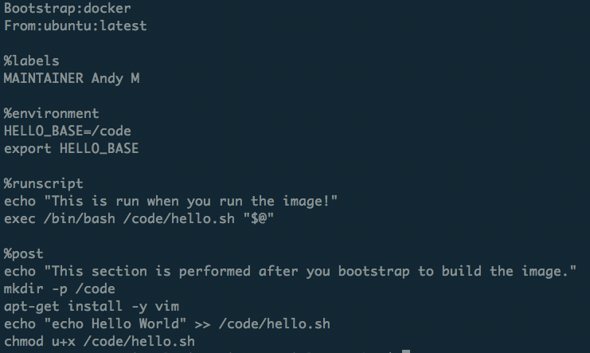
What is a recipe?
Header
Metadata
Runtime environment variables
Default program at runtime
Where software and directories are installed at buildtime
More: https://www.sylabs.io/guides/3.2/user-guide/definition_files.html

Slide 16
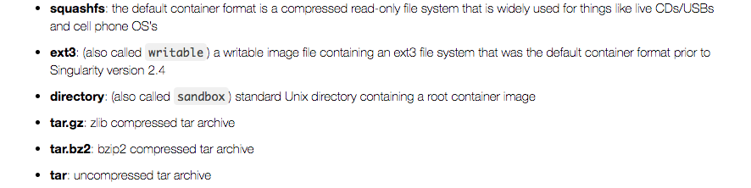
Container Formats
*.sif format and older *.simg format
(immutable final container format)
Writeable sandbox used for interactive container development
https://singularity.lbl.gov

Slide 17
1. Building a container interactively (demo)
Bootstrap a base container (has OS you want, maybe other stuff too) into a sandbox:
sudo singularity build --sandbox mytest/ docker://alpine:latest
Shell into the container and install what you need by trial and error:
sudo singularity shell –-writable mytest/
[now do stuff in container; as you get it correct, add commands to Singularity recipe]
Now finalize container.
You can either build squashfs image from sandbox:
sudo singularity build mytest.sif mytest/
Or you can build squashfs image from recipe (best practice):
sudo singularity build mytest.sif Singularity

Slide 18
2. Building a container with Sylabs Remote Builder (demo)
Get a token from Sylabs Cloud: https://cloud.sylabs.io/auth
Login using your Github account
Create a new token under “Keystore”
Copy the token string (<your-token>)
Add the token on your host machine:
singularity remote login
Then paste your token when prompted.
Issue the command to build your container remotely
singularity build --remote myimage.sif Singularity
…where “Singularity” is your definition file. If successful, the container will be placed in your working directory

Slide 19
Thank you!
Please fill out the survey:
http://tinyurl.com/curc-survey18
Contact information:
Andrew.Monaghan@Colorado.edu
Additional learning resources:
Slides and Examples from this course:
https://github.com/ResearchComputing/Containers_Fall_2021
Web resources:
https://www.sylabs.io/guides/3.6/user-guide/ (user guide for Singularity)
https://www.singularity-hub.org/ (Singularity Hub)

Slide 20
Extra slides
Seacontainersales.com

Slide 21
Hands-on Example
Build a container on Singularity Hub
Seacontainersales.com

Slide 22
Notes: MPI and GPUs
Seacontainersales.com

Slide 23
Notes: MPI-enabled containers
HPC systems use low-latency interconnects (“fabric”) to enable MPI to be efficiently implemented across nodes). In order to use a Singularity container with OpenMPI (or any MPI) on a Supercomputer there are two requirements:
The Singularity container needs to have the fabric libraries installed inside.
OpenMPI needs to be installed both inside and outside of the Singularity container. More specifically, the SAME version of OpenMPI needs to be installed inside and outside (at least very similar, you can sometimes have two different minor versions, ex: 2.1 and 2.0).

Slide 24
Running containers on GPUs
Syntax (after loading Singularity on a gpu node):
singularity exec --nv docker://tensorflow/tensorflow:latest-gpu python mytensorflow_script.py
With the --nv option the driver libraries do not have to be installed in the container. Instead, they are located on the host system (e.g., Teton) and then bind mounted into the container at runtime. This means you can run your container on a host with one version of the NVIDIA driver, and then move the same container to another host with a different version of the NVIDIA driver and both will work. (Assuming the CUDA version installed in your container is compatible with both drivers.)
The NVIDIA Driver version on a GPU node can be queried (when on that node) with the command nvidia-smi. See https://docs.nvidia.com/deploy/cuda-compatibility/
You can build a container by bootstrapping a base NVIDIA CUDA image (with a compatible CUDA version) from: https://hub.docker.com/r/nvidia/cuda/
NVIDIA has a tool for building gpu-enabled containers for both Singularity and Docker. See: https://github.com/NVIDIA/hpc-container-maker

Slide 25
Troubleshooting and Caveats
Seacontainersales.com

Slide 26
Troubleshooting (1)
Container/host environment conflicts
Container problems are often linked with how the container “sees” the host system. Common issues:
The container doesn’t have a bind point to a directory you need to read from / write to
The container will “see” python libraries installed in your home directory (and perhaps the same is true for R and other packages. If this happens, set the PYTHONPATH environment variable in your job script so that it points to the container paths first.
export PYTHONPATH=<path-to-container-libs>:$PYTHONPATH
To diagnose the issues noted above, as well as others, “shelling in” to the container is a great way to see what’s going on inside. Also, look in the singularity.conf file for system settings (can’t modify).

Slide 27
Troubleshooting (2)
Failures during container pulls that are attributed (in the error messages) to *tar.gz files are often due to corrupt tar.gz files that are downloaded while the image is being built from layers. Removing the offending tar.gz file will often solve the problem.
When building ubuntu containers, failures during %post stage of container builds from a recipe file can often be remedied by starting the %post section with the command “apt-get update”. As a best practice, make sure you insert this line at the beginning of the %post section in all recipe files for ubuntu containers.
https://singularity.lbl.gov

Slide 28
Caveats (1)
We didn’t cover overlays. These are additional images that are ”laid” on top of existing images, enabling the user to modify a container environment without modifying the actual container. Useful because:
Overlay images enable users to modify a container environment even if they don’t have root access (though changes disappear after session)
Root users can permanently modify overlay images without modifying the underlying image.
Overlays are a likely way to customize images for different HPC environments without changing the underlying images.
More on overlays: http://singularity.lbl.gov/docs-overlay
We didn’t cover GPU usage with containers. See: http://singularity.lbl.gov/archive/docs/v2-3/tutorial-gpu-drivers-open-mpi-mtls

Slide 29
Caveats (2): Moving containers
You’ve built your first container on your laptop. It is 3 Gigabytes. Now you want to move it to Summit to take advantage of the HPC resources. What’s the best way?
Remember, containers are files, so you can transfer them to Summit just as you would a file:
Command line utilities (scp, sftp)
Globus (recommended)
For more on data transfers to/from Summit: https://github.com/ResearchComputing/Research-Computing-User-Tutorials/wiki/Data-Transfers

